Slide 1
Exploring The Relationship Between Internet Access And Economic Growth
Using World Development Indicators
Ogbe Oghenefegor Annabel

Slide 2
BACKGROUND CONTEXT
The internet has become one of the main key drivers so economic and social development in the 21st century, having transformed the way people communicate, conduct businesses, access information and deliver public services. Countries continue to invest in digital infrastructure, which shows that there is growing interest to understanding whether increased internet access contributes to sronger economic performance.
Economic growth are measured using indicators such as Gross Domestic Product (GDP)
While many developed countries with widespread internet access also experience high levels of economic output, the relationship is not always straightforward. Factors such as education, infrastructure, government policies, political stability, and investment also play significant roles in shaping economic outcomes.
This project explores the relationship between internet usage and economic performance across countries Using data from the World Bank's World Development Indicators (2021–2025), Through interactive visualizations in Power BI, the analysis aims to identify patterns, compare countries, and provide evidence-based insights into how digital connectivity relates to economic development.

Slide 3
PROBLEM STATEMENT
This project seeks to explore the relationship between internet usage and economic performance using world bank data to identify trends and patterns across countries.
PROJECT OBJECTIVE
The objective of this project was to analyze whether increased internet access is associated with stronger economic growth across countries using data from the World Bank's World Development Indicators.
The dashboard was designed to:
Examine global trends in internet usage and economic performance.
Compare countries using key development indicators.
Identify relationships between internet access, GDP growth, GDP per capita, and population.
Present insights through an interactive Power BI dashboard that supports data-driven decision-making.

Slide 4
Research Questions
Is there a relationship between internet usage and GDP growth across multiple countries?.
Do countries with higher internet usage have higher GDP Per capita?.
How has internet usage changed across countries between 2021 - 2025?.
Which country recorded the highest and lowest GDP growth during the period of study?.
Which country recorded the highest and lowest Internet usage during the period of study?.
Are there countries with high internet usage but low economic growth and vice versa?.

Slide 5
DATASET OVERVIEW
SOURCE: World Bank- World Development Indicators (WDI)
PERIOD: 2021 - 2025
INDICATORS USED:
Population of individuals using the internet
GDP growth per capita(Current US$)
GDP growth(Annual%).
Total Population.
DATASET FEATURES:
Multiple countries
Annual observations
Economic and digital development indicators
Country-level development statistics

Slide 6
CLEANING PROCESS
The following preprocessing steps were carried out before analysis:
Imported the dataset into Power BI.
Removed unnecessary columns.
Checked for duplicate records.
Handled missing values where necessary.
Corrected data types.
Renamed columns for readability.
Created calculated measures using DAX for KPI cards.
Applied filters and slicers to improve dashboard interactivity.

Slide 7
ANALYSIS PERFORMED
The dashboard focused on descriptive analysis using Power BI.
The analysis included:
Internet usage trends across countries.
Comparison of GDP growth between countries.
GDP per capita comparison.
Population comparison.
KPI analysis using DAX measures.
Filtering by country and year.
Interactive visual exploration to identify relationships among indicators.

Slide 8
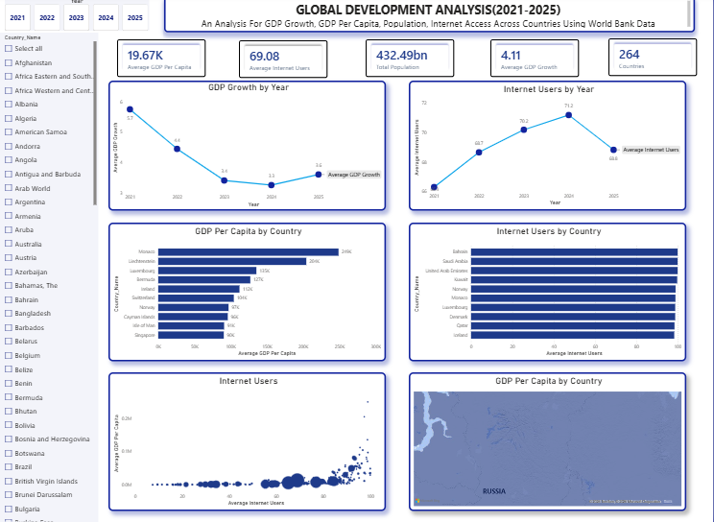

Slide 9
DASHBOARD WALK THROUGH
Dashboard Walkthrough
Dashboard contains:
KPI Cards.
Average GDP Growth.
Average GDP Per Capita.
Average Internet Usage.
Total Population (or Average Population, depending on your measure).
VISUALIZATION:
Bar charts comparing countries.
Line charts showing yearly trends.
Scatter plot illustrating the relationship between internet usage and GDP growth.
Slicers for Year and Country.
Interactive filters allowing users to explore specific regions or countries.
Users can easily select a country or year to observe how economic indicators change over time.

Slide 10
KEY INSIGHTS
Eastern and Southern Africa recorded good GDP growth in some years even though internet usage was relatively low. This shows that other factors may have contributed to economic growth in the region.
Some countries had very low internet usage throughout the 2021–2025 period. This suggests that internet access is still limited in these countries.
Andorra's internet usage increased, but its GDP growth declined during the same period. However, it continued to have a high GDP per capita.
There was no clear pattern between internet usage and GDP growth across all countries. Some countries with high internet usage had strong economic growth, while others did not.
Burundi had one of the lowest average internet usage rates (about 7%) and also recorded a low GDP per capita (about US$253).
Monaco had both high internet usage and one of the highest GDP per capita values in the dataset. This reflects its strong economy, although internet usage alone does not explain its economic success.

Slide 11
RECOMMENDATIONS
Government should improve internet access, especially in countries where internet usage is still low.
Invest in education, healthcare, transportation, and business development, because internet access alone cannot drive economic growth.
Make internet services more affordable and help people develop digital skills.
For further analysis include more economic indicators, such as unemployment, inflation, and foreign investment, in future analyses for a better understanding of economic performance.
Use internet usage together with other economic indicators when measuring a country's economic development.

Slide 12
CONCLUSION
The analysis revealed that while countries with higher internet usage often exhibited higher GDP per capita, the relationship between internet usage and GDP growth was not consistent across all countries.
The dashboard demonstrates the value of data visualization in uncovering patterns and supporting evidence-based decision-making. It also highlights the importance of considering multiple economic indicators when evaluating the relationship between digital connectivity and economic development.

